Slide 1
Lighting for Computer Graphics
CAS 741 | Sasha Soraine
Notes:
I need your help – because I’m having a hard time separating implementation details, and specifically approximation and design decisions made for implementation reasons, from the abstract details I’m looking to document here.

Slide 2
Problem Statement
Understand how light interacts with objects with different material properties and model it for virtual environments.
Words to know:
Computer graphics
Virtual environment
Material Properties

Slide 3
Binding Time: Scope
Understand and model geometrical optics simulation of light interacting with material objects.
Optics
Geometrical Optics
Wave Optics
Words to know:
Geometrical Optics
Rays
Wave Optics

Slide 4
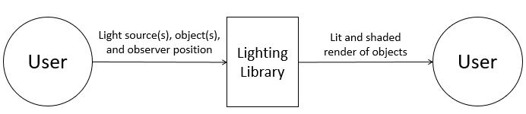
Words to know:
Light source
Observer
Render
Shaded/Shader
Lit

Slide 5
Goal Statements
Given some light source(s), some object(s), and an observer:
GS1: Generate a fully lit and shaded scene of the object(s) based on the observer location and positions and material properties of the object(s).
GS2: Predict the light ray(s) reflected from the object(s) to the observer.
GS3: Calculate the vectors for light ray(s) reflected off the object(s) based on light source(s).
GS5: Calculate the shading for different parts of the object based on light source(s) and observer positions.
GS4: Compute the normal vectors for object(s) surfaces.

Slide 6
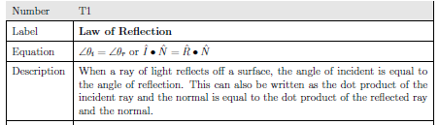
Theoretical Models
Words to know:
Angle of incidence
Incident Ray
Normal
Dot Product

Slide 7
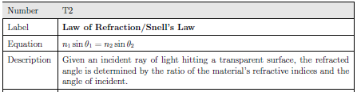
Theoretical Models
Words to know:
Refractive index
Transparent

Slide 8
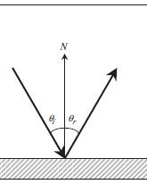
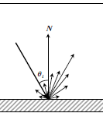
General Definitions
Specular Reflection
Diffuse Reflection
Words to know:
Specular
Diffuse
Notes:
Should these be general definitions or are these instances of the theoretical model?
They both are the law of reflection, but they become relevant in shading based on material properties.
Their distinction becomes extra important when we start making more considerations about the system.

Slide 9
Variabilities to Consider
Object
Material properties
refractive index of object
how shiny/glossy it is
Number of objects
Light source
Type of light source (ambient, point, spotlight, directional, etc.)
Number of light sources
Notes:
There is an implicit design decision here which I haven’t talked about because I’m not sure where to put it: global vs. local illumination.
Generally I want this document to be written to accommodate both, and eventually I’d want it to handle both.
This distinction only makes sense in the context of graphics implementation – because all real world lighting is both global and local.

Slide 10
Assumptions to simplify the problem
A1: All objects are opaque.
No refraction.
Can’t handle modeling water or glass.
Notes:
This simplifies everything to simple reflection problems. This is a common assumption in computer graphics as modeling water or glass in a photorealistic way is complicated and time consuming.

Slide 11
Related Likely Changes
LC1: Objects can be transparent.
Incorporates refraction.
Can handle modeling water or glass.
Notes:
This simplifies everything to simple reflection problems. This is a common assumption in computer graphics as modeling water or glass in a photorealistic way is complicated and time consuming.

Slide 12
Variabilities to Consider (Redux)
Object
Mesh complexity
Material properties
refractive index of object
how shiny/glossy it is
Number of objects
Light source
Type of light source (ambient, point, spotlight, directional, etc.)
Number of light sources
Interpolation Technique
None, by vertex, by mesh geometry, continuous
Reflection Model
Global vs. local illumination
Notes:
Should interpolation technique and reflection model be variations in input? I’ve left them for the binding time to be at run time because I think it would be most robust/useful that way.
This may change depending on project.
The global vs. local illumination adds more theoretical models because global illumination imposes more rules on geometrical optics using things like bi-directional reflective distribution functions which are based on more complex integrals that define some of light’s properties.

Slide 13
Variabilities to Consider (Input and Output)
Input can be given by:
Separate files with list of light sources, objects, and observer and their respective properties.
Function call inside a program.
Output can be given:
Code that generates the image.
Screen with rendered scene.
Notes:
Should interpolation technique and reflection model be variations in input?

